Slide 1



Predictors of High School Dropout
Beyond Risk Factors
Salesforce Data Science Challenge:
Tawny Tsang
Landon Gibson
Arad Saebi
Lilian Jiang
Terry Allen
Notes:
**What is our title?

Slide 2
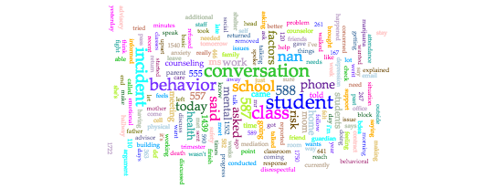
Do we know whom we serve?
Notes:
Dropouts typically fall into four broad categories. They 1) failed to succeed academically, 2) faded out over time, 3) were pushed out by their schools, or 4) left school because of life events. iving with natural parents (HS).
drop out factors: individual, family, school and community factors

Slide 3

The dropout challenge
74% of high school dropouts regret their decision (Bridgeland et al, 2005)
Students cite inadequate social, emotional, and academic support (Bridgeland, 2010)
Increasing support and guidance for post-secondary options reduce dropout rates by 10%, but are costly (~$14,000/student) (Pathways—Oreopoulos et al., 2014)
Notes:
Leaving school early is associated with long-term costs both to the individual (i.e., income earned, higher rates of incarceration) and to society (welfare costs…)
Bridgeland article: https://eric.ed.gov/?id=ED513444
Lack of social support at home, apathy/boredom, and perceived lack of relevance are large factors for dropping out:http://files.eric.ed.gov/fulltext/ED509756.pdf
Canadian intervention study Pathways to Education: Counseling, Academic, Social and Financial support—including mandated tutoring 2x a week, access to a counselor, parental involvement, and financial incentive for post-secondary school options (college) : http://chairepro.mobme.info/uploads/43_Oreoupoulos%20et%20al.%20Pathway%20to%20Education%202014.pdf

Slide 4
Predictive Analysis: Results
What do our data reveal?

Slide 5
Model Performance on Test Data
Model Description | AUC | AUC: 95% Lower CI | AUC: 95% Upper CI | Accuracy | Specificity | Sensitivity
Naïve Bayes | 0.978 | 0.954 | 1.000 | 0.946 | 0.903 | 0.967
Random Forest | 0.964 | 0.929 | 0.999 | 0.891 | 0.742 | 0.967
Gradient Boosted Machine | 0.961 | 0.926 | 0.997 | 0.913 | 0.903 | 0.918
Boosted Classification Tree | 0.959 | 0.923 | 0.994 | 0.902 | 0.871 | 0.918
Elastic-Net Regularized General Linear Models | 0.958 | 0.923 | 0.993 | 0.902 | 0.903 | 0.902
Neural Network | 0.938 | 0.890 | 0.986 | 0.880 | 0.903 | 0.869
AdaBoost Classification Trees | 0.907 | 0.839 | 0.974 | 0.891 | 0.839 | 0.918
Note: Positive case is when students do not dropout

Slide 6
A Closer Look at Test Predictions
Naive Bayes
 | Truth
Prediction | Didn’t Dropout | Dropped Out
Didn’t Dropout | 59 | 3
Dropped Out | 2 | 28
Specificity = 28 / (28 + 3)
Sensitivity = 59 / (59 + 2)

Slide 7
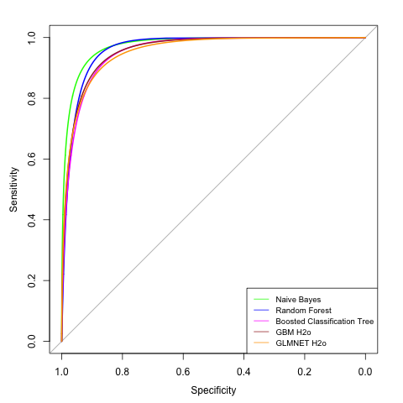
Graphical Comparison
Naive Bayes Model predicts which students will dropout with 90.3% Specificity and 96.7% Sensitivity on test data
Notes:
Absent rate. Flagged drop outs and people
People who didn’t drop out—any term that wasn’t their first or last
People who dropped out, term before they dropped out.
Randomly selected terms, age at entrance, # exemptions, services, machine learning
Training and test set. 70% trained, 30% testing.
Great area under curve Specificity: drop out sensitivity is non-dropout. We caught a large number of studnets who will drive out and and high sensitivity
ALSO PUT THE TABLE in the slides!

Slide 8
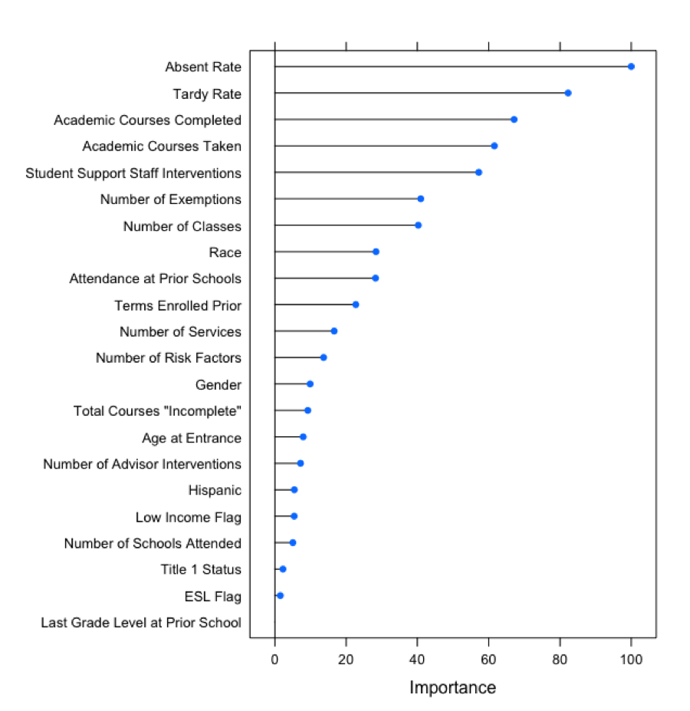
Notes:
Things to highlight: Absent Rate and Tardy Rate were very important to the model. corroborates existing literature citing lack of student engagement as a contributing factor for drop out

Slide 9
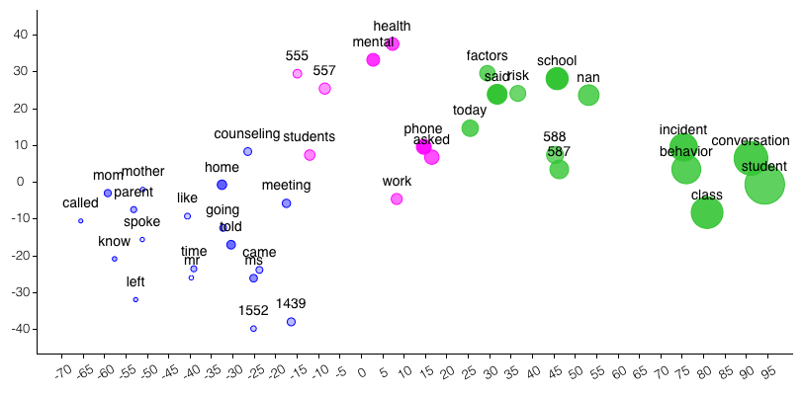
Textual analysis
Notes:
Challenges the students are experiencing
Text analysis. # are students
Mental health, factors, school today work
Intervention pov
No single risk factor can predict dropouts but accuracy increases when combinations of multiple risk factors are considered. In addition, there are complex interactions among risk factors and across domains that lead to the process of dropping out. The most significant risk factors (significant if statistically significant results in 2+ studies across all 3 school levels) though are low SES, poor attendance, low achievement and retention/over-age for grade. Other factors identified as a statistically significant predictor by two or more studies in at least one school level (parentheses indicate which school level they are significant) are high number of work hours (High School), parenthood (HS), high-risk peer group (MS), high-risk social behavior (MS), low educational expectations (MS, HS), Low commitment to school (HS), No extracurricular participation (HS), misbehavior (HS), high family mobility (MS), Low educational levels of parents (HS), and not living with natural parents (HS).

Slide 10
Conclusions
Student involvement in educational plan may increase motivation and interest in schooling
For nontraditional students, the importance of long-term benefits need to be apparent to offset short-term costs of completing secondary school
Dropping out of school is related to a variety of factors that can be classified in four domains: individual, family, school and community factors
Notes:
http://freakonomics.com/2014/12/04/how-to-fix-a-broken-high-schooler-in-four-easy-steps-full-transcript/

Slide 11
Future Directions
Researchers
More preprocessing & tuning
Utilizing text data in predictive models
Capturing all four domains: individual, family, school and community factors
Practitioners
Identify key transition points in students’ school career
Build an Early Warning System
Implement culturally relevant and responsive curriculum and instruction
Use a Tiered Prevention and Intervention System grounded in personalization, care, the transition to “adulthood”
Notes:
What were some limitations of our models?
What factors contributed the most to dropping out? What additional information would be helpful to inform dropout rates?
How do we use these analyses to help educators bridge the gap with students?

Slide 12
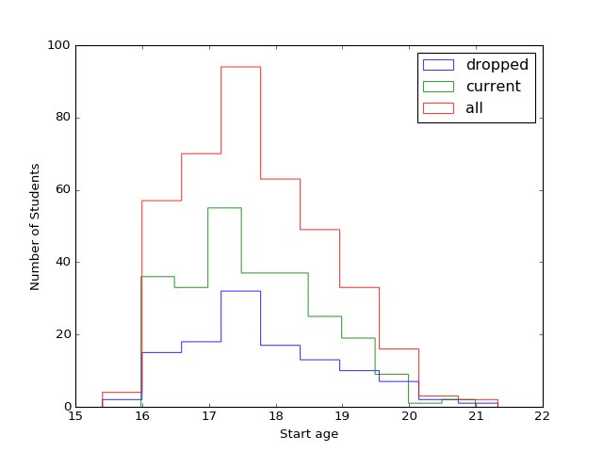
Age (??)

Slide 13
Factors Associated with Dropout
Generating prediction model of dropout rates in BDEA students
What were the covariates?
Analyze transcripts between students and counselors

